Slide 1
POWER BI PROJECT
The Finance Department of ABC Company Analysis
Presented By: Mujaheed,
Abhilash and
Offori

Slide 2
Business Case:
Company
Context
Problem statement
ABC Company Finance Department maintains the invoice level details of all Payroll vendors and the cost associated with generating payslips for their employees.
The Global Finance leader and other Country-level Finance leaders seek data from these analysts to identify the Per Payslip Costs (PPC), which helps them negotiate with vendors to reduce the overall cost for the company.
Since data is being captured for different regions by separate analysts, there is no way the Global leader could view the real-time global metrics.
He has to wait for all the Country/Region-specific leaders to share their metrics with him.

Slide 3
Solution
We'll collate all the Region-specific sheets in one file, clean all unwanted data and map it with the other master tables and create an automated dashboard solution that can serve all.

Slide 4
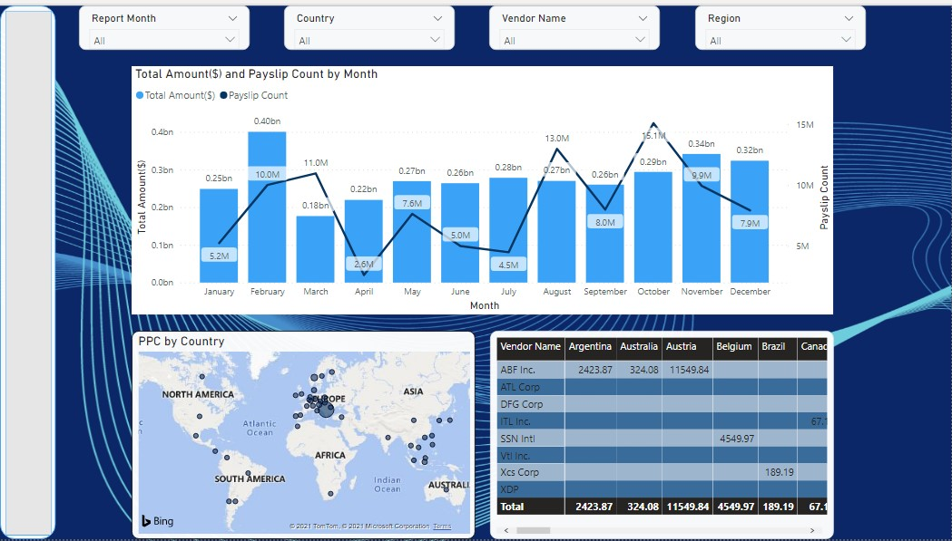
DASHBOARD
Notes:
This is our final dashboard, we choose these charts to make it more attractive to our stakeholders. moreover, these colors represent ABC Company. I will work you through the individual chart one after the other from the next slide

Slide 5
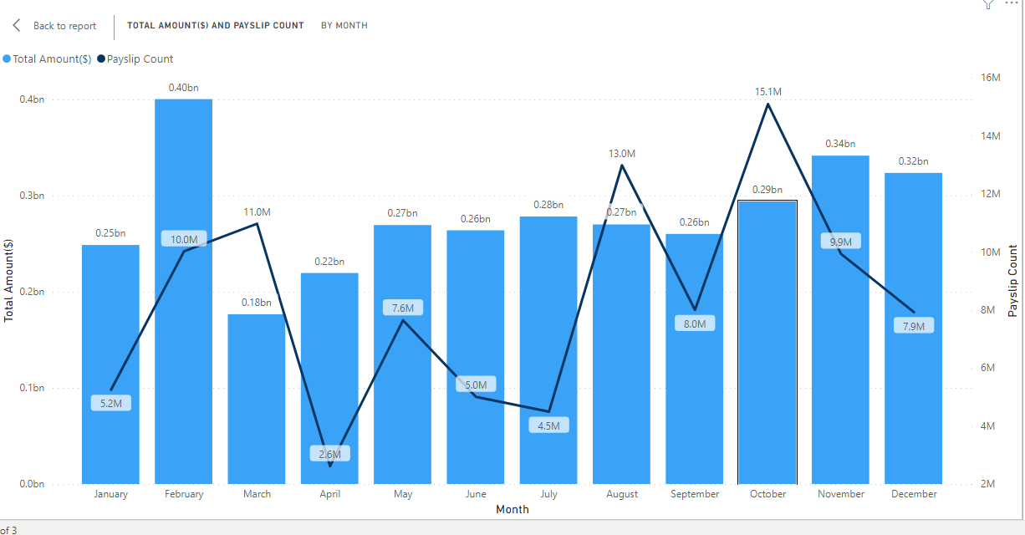
Total Amount And PaySlip Count Per Month
It was observed that there was the highest Total Amount in the month of February compared to others.
It was also observed that there was a higher Payslip in October compared to its Total Amount in the same month.
Notes:
We plotted three different variables in this combined chart to illustrate the Total Amount and Payslip count Per month.

Slide 6
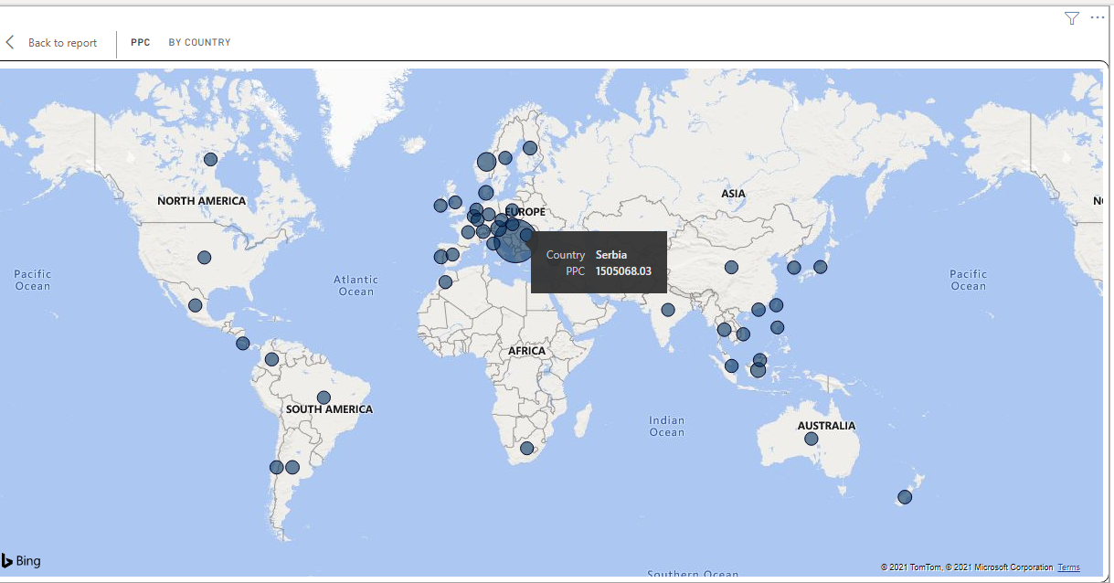
PPC BY Country
We Observed that Serbia has the highest PPC value which is obvious from the map.
Notes:
The Map was plotted to illustrate PPC (i.e the Per Payslip Cost) By Country , Where the bubbles represent the degree of PPC in each Country.

Slide 7
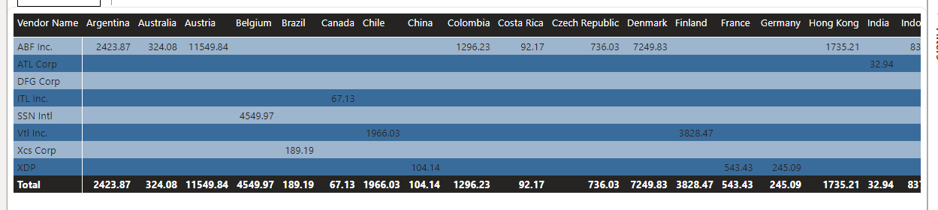
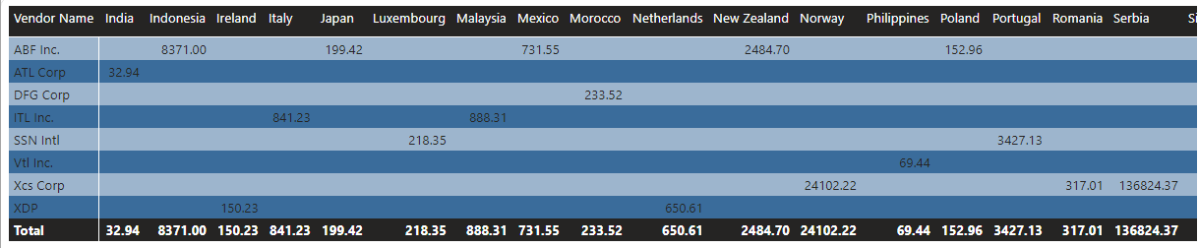
Vendors, country, and average PPC Matrix
It was observed that all vendors are catering to more than 1 country and there is a significant variance in the Average PPC values. Except for the ATL Corp vendor.
We can say that the highest scope for negotiation lies for XCS Corp & ABF Inc.
Notes:
We tried to Identity vendors catering to more than one country and compare their PPC values on the above Visual Matrix

Slide 8
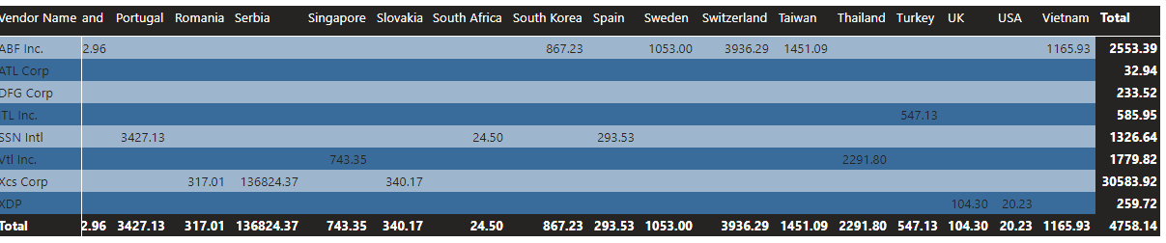
We noticed that DFG Corp has a presence in Morocco, Greece, and Russia.
Meanwhile, there’s no amount or payslip information available for Greece and Russia.
Notes:
We also identified vendor which caters to more than one country but hasn’t reported any invoices for 2020

Slide 9
Suggestions And Recommendations
PPC is (Total Amount/Payslip Count), so is either we reduce the amount or increase the Payslip count in order to minimize the Per Payslip Costs.
This can be achieved by adding more headcount to the country as more headcount means more payslips generated to the vendor.
Notes:
After our analysis, we noticed that in the EMEA region, Serbia has the highest average PPC value, We there recommend the following points to reduce the PPC in Serbia

Slide 10
Thank You!

